Slide 1

Building Information Architecture
A GUIDE TO WASHINGTON DC FOR
LOW VISION VISITORS

Slide 2
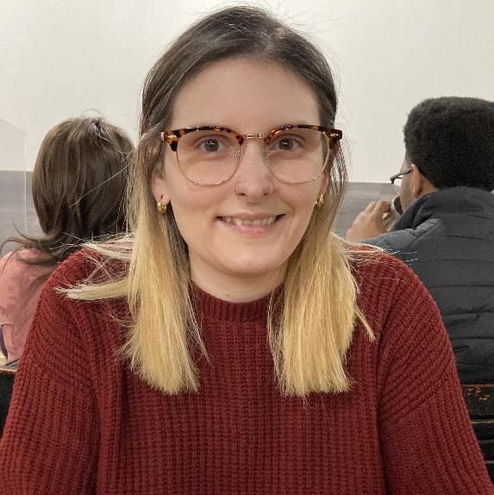
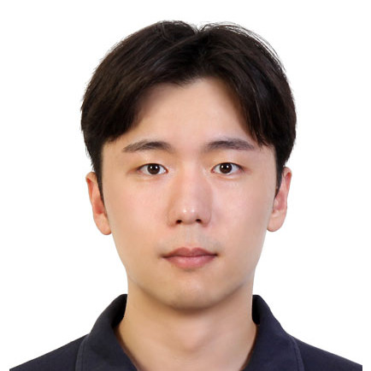

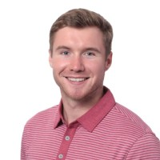
Team
Addy Elketami
GieMyung Lee
Yixin Yin
Benjamin Stevenson
Notes:
Put our persona here

Slide 3
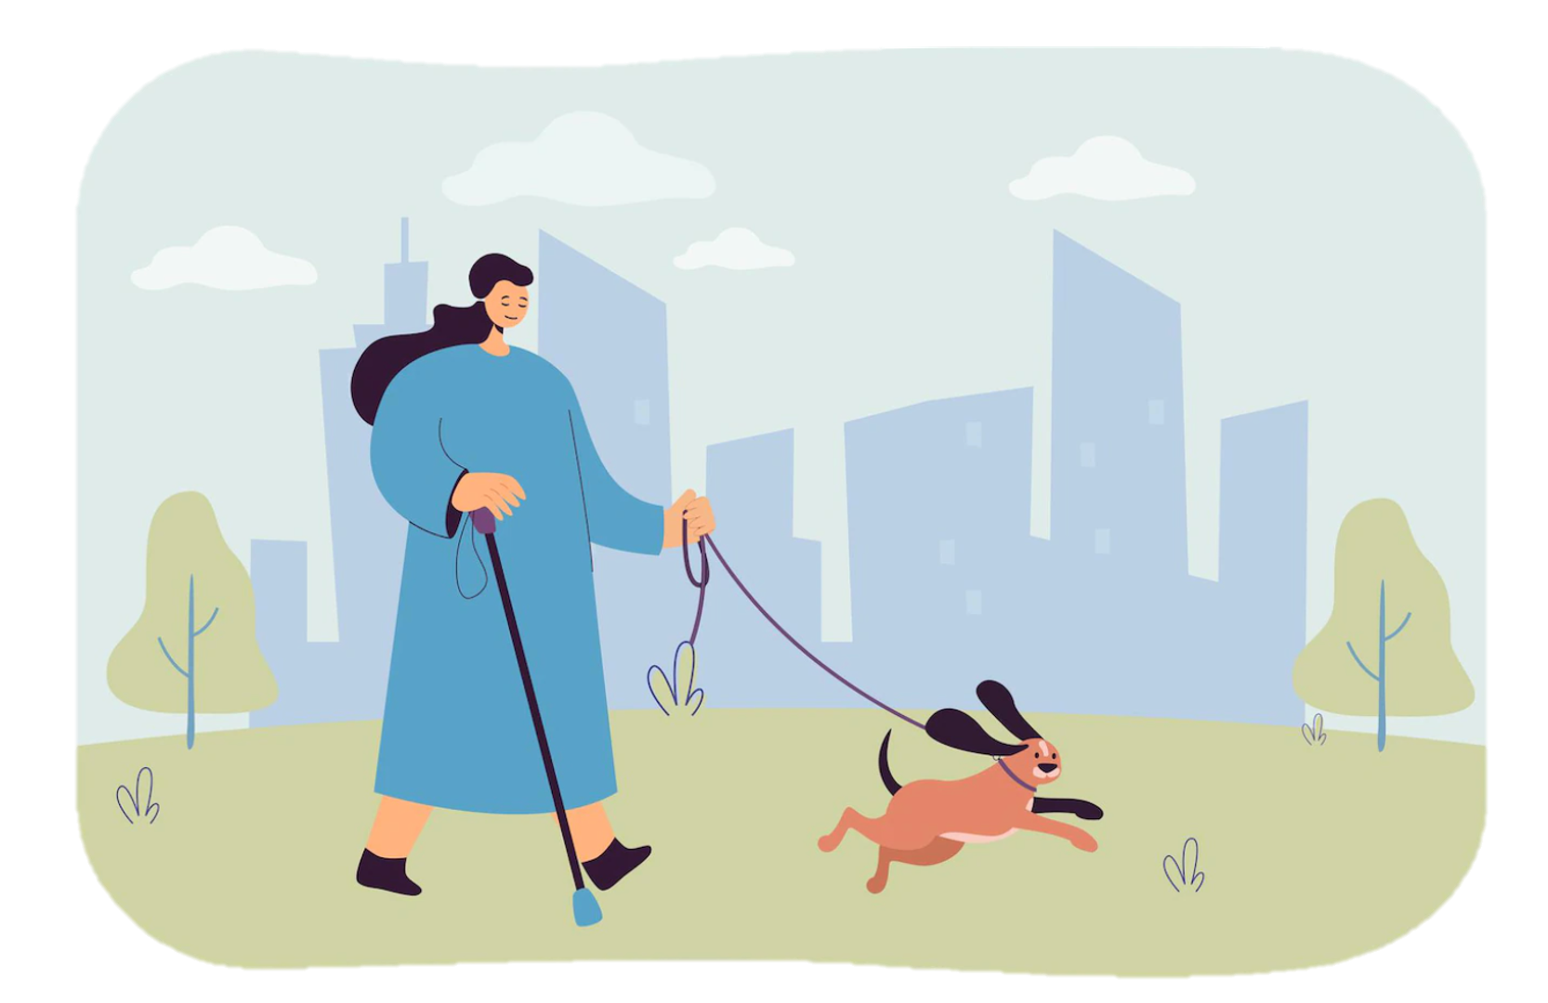
Project Overview
The project is based around developing an accessibility enhanced tour guide website or an application like TripAdvisor.
We chose Washington DC because it is a popular tourist destination with many attractions to offer for many interests.
Most attractions in Washington DC have accessibility service that enhance the experience of visitors with accessibility needs.
We focused on low vision users but expanded our taxonomy to focus on different types of low vision users with other accessibility considerations.
Notes:
Our approach to building the guide, taxonomy, ontology, knowledge graph, linked data, etc.

Slide 4
Approach
Research types of low vision and accessibility resources offered by popular attractions.
Build our taxonomy around publicly available information about attractions, neighborhoods, accessibility services, and transportation focused around user interests and preferences.
Base our taxonomy and ontology creation around different tourist user types and scenarios.
Use “middle out” taxonomy creation approach.
Link data from DbPedia to create a more robust taxonomy.
Develop attributes to assist in faceted searching.
Use knowledge graph creation to map out relationships between taxonomy terms and linked data for our user types and scenarios.
Notes:
Our approach to building the guide, taxonomy, ontology, knowledge graph, linked data, etc.

Slide 5
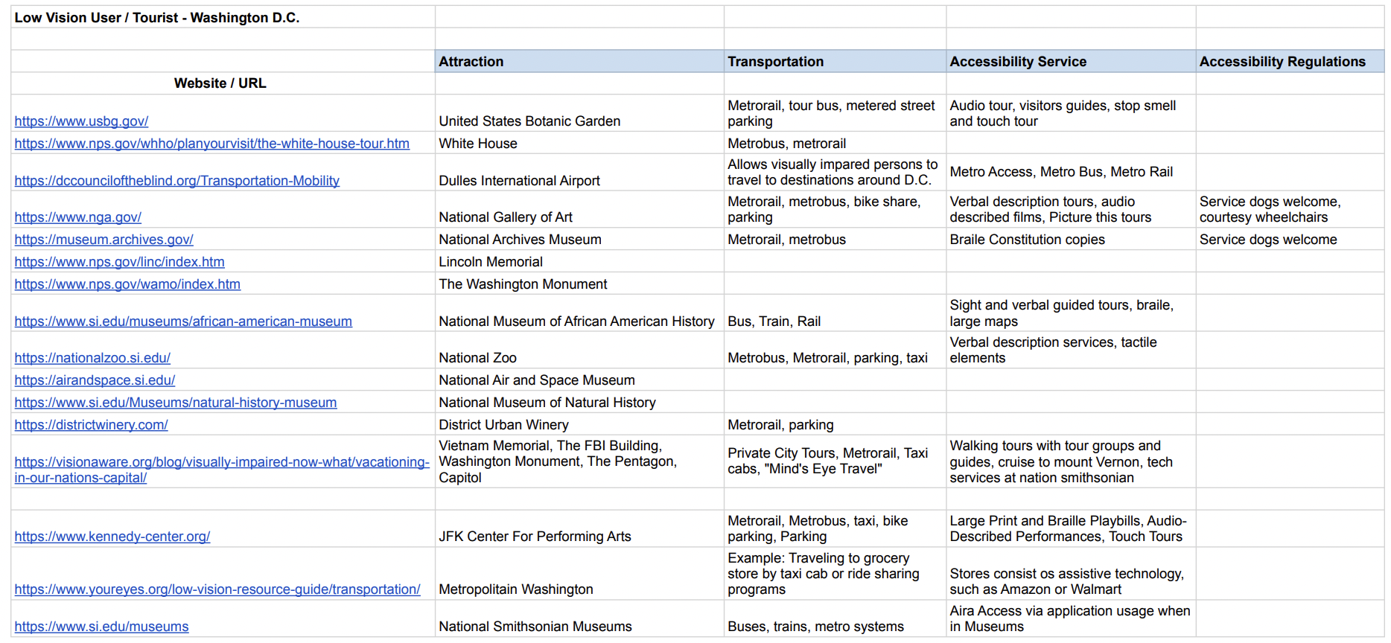
Approach
Research types of low vision and accessibility resources offered by popular attractions.
Build our taxonomy around publicly available information about attractions, neighborhoods, accessibility services, and transportation focused around user interests and preferences.
Base our taxonomy and ontology creation around different tourist user types and scenarios.
Use “middle out” taxonomy creation approach.
Link data from DbPedia to create a more robust taxonomy.
Develop attributes to assist in faceted searching.
Use knowledge graph creation to map out relationships between taxonomy terms and linked data for our user types and scenarios.
Notes:
Our approach to building the guide, taxonomy, ontology, knowledge graph, linked data, etc.

Slide 6
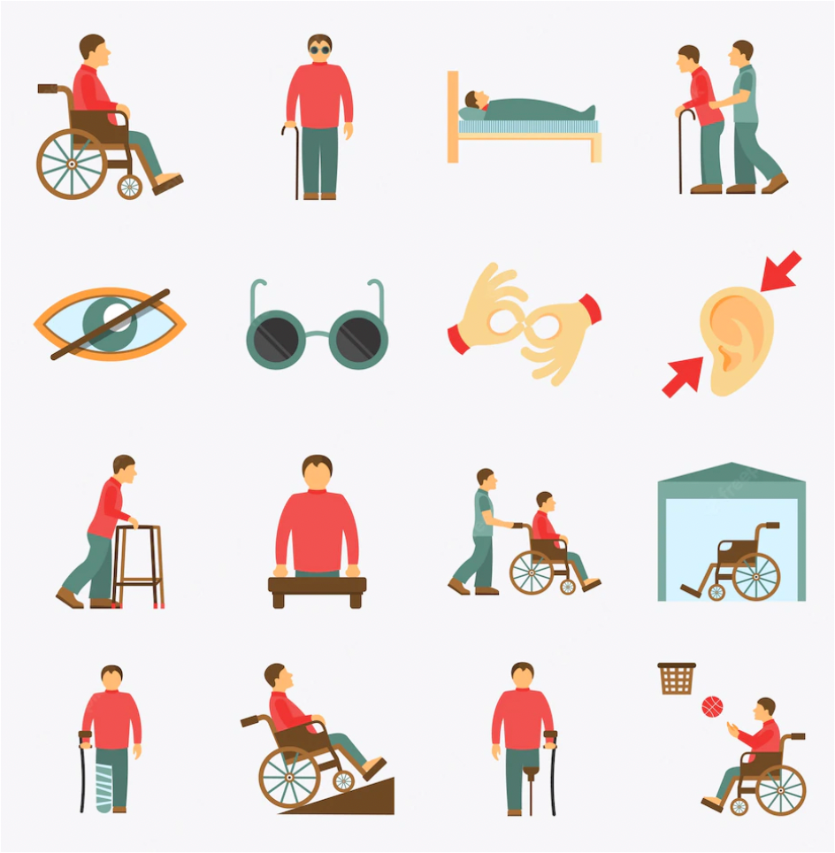
User Types
Notes:
Our approach to building the guide, taxonomy, ontology, knowledge graph, linked data, etc.

Slide 7
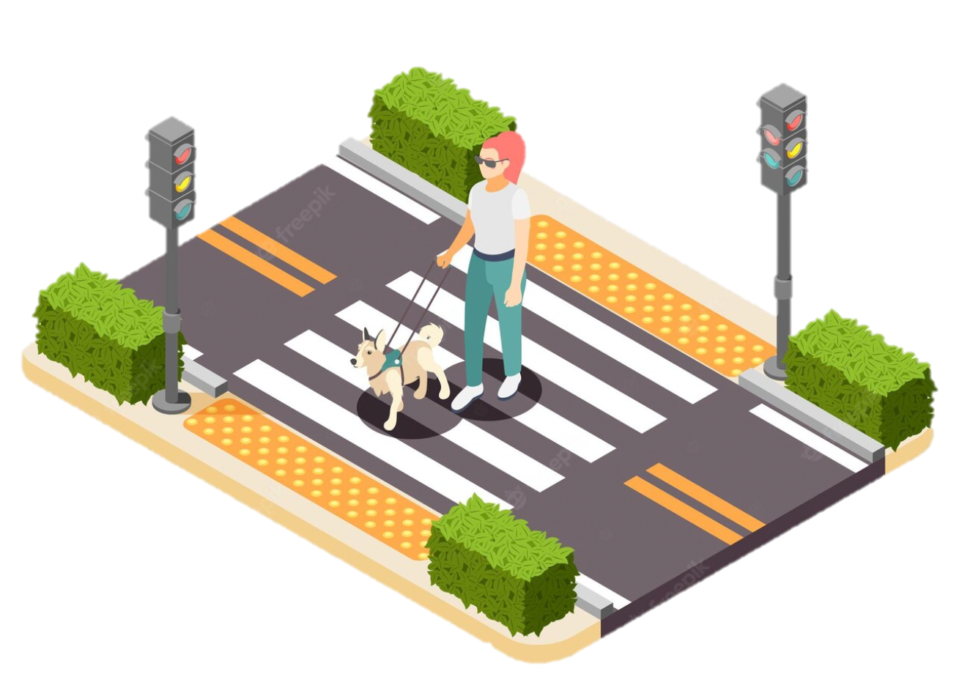
User 1
Independent low vision traveler.
Interested in sciences and history mostly.
Everyday technology user
Active and likes to walk around the neighborhood and be outside.
Low vision but is not completely blind and uses accessibility features (including screen zoom, larger font, and sometimes audio settings) on her phone and computer to aid in her.
Finds low vision to be somewhat of a barrier to the experience where low vision accessibility features or services are not offered.
Notes:
Put our user types here

Slide 8
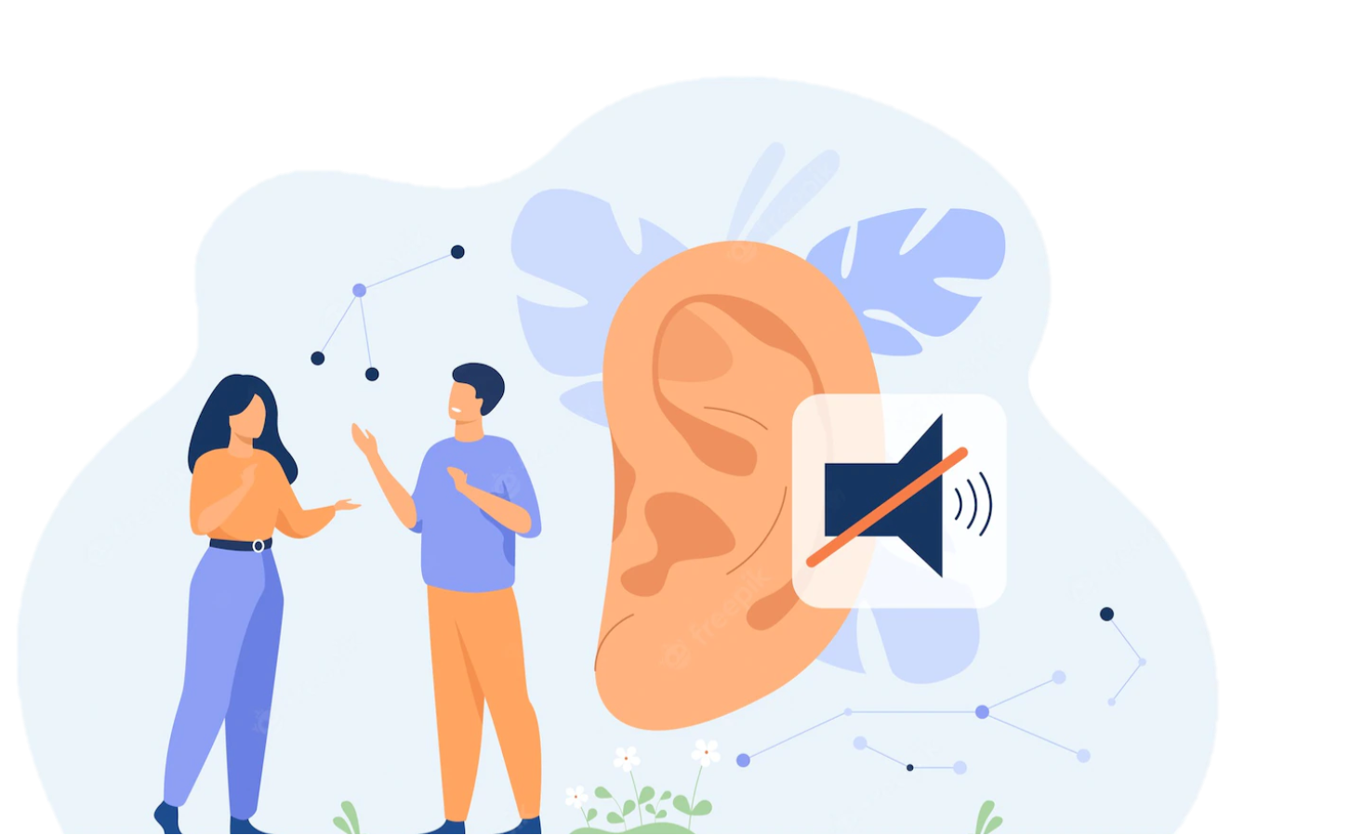
User 2
Has auditory constraints but is interested in visiting new places.
Would benefit from being included in tour groups so as to not feel excluded from others around them.
Not absolutely necessary but could benefit from an ASL interpreter when visiting attractions.
Interested in classical art and history.
Notes:
Put our user types here

Slide 9
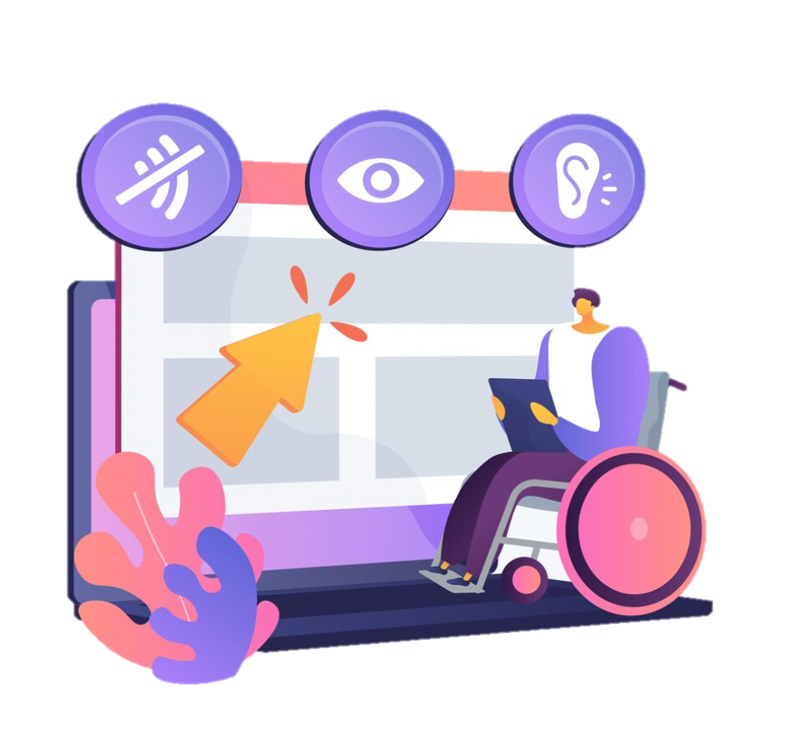
User 3
Older traveler with physical limitations.
Travels with whole family.
Has some vision and mobility difficulties and an electric wheelchair must be able to enter when visiting an attraction.
Was a soldier who participated in the Vietnam war, and his main interests are war and history.
Seeing is not a priority, but needs a guide who can explain and lead the tour.
Prefers to visit a place where veteran discounts or free access is provided.
Notes:
Put our user types here

Slide 10
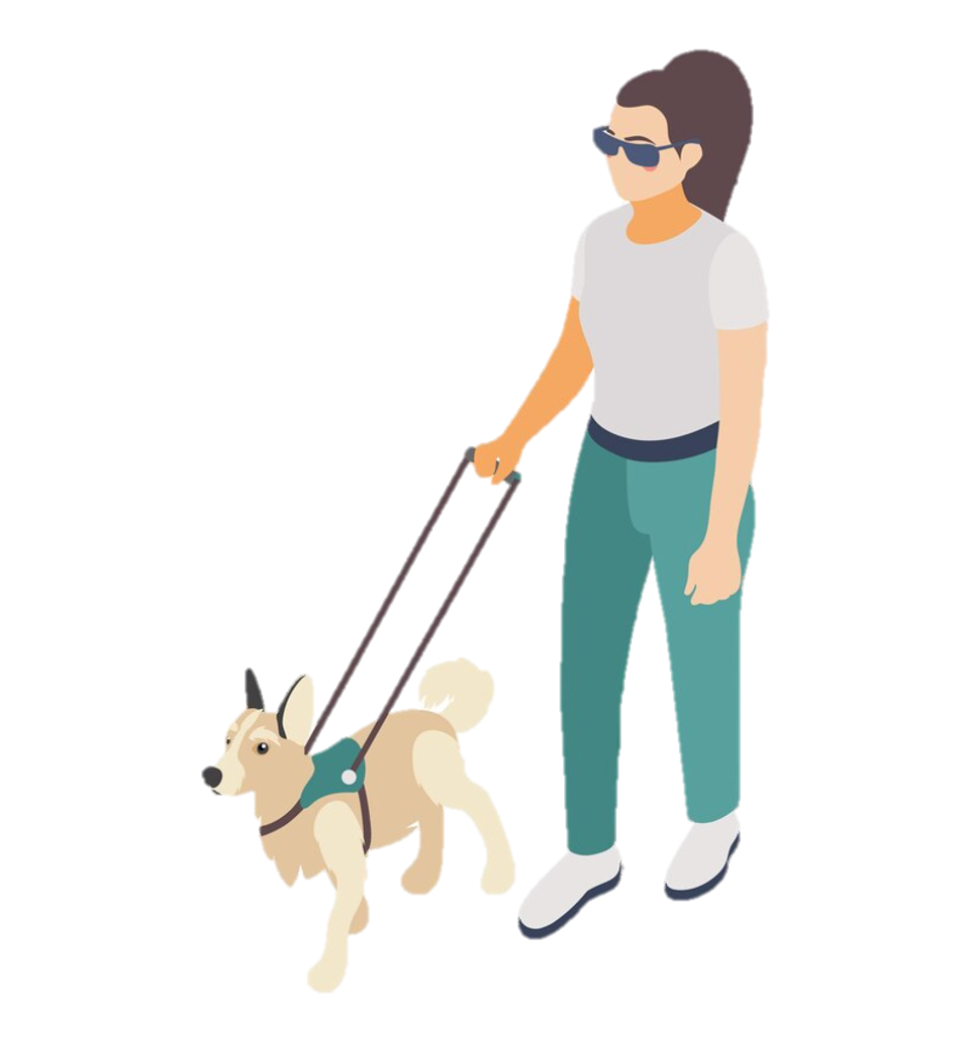
Scenario for Use
User 1
Low vision traveler spending a day in Washington DC to enjoy the city after a work meeting trip and is staying in Downtown DC.
Because she has one day, she wants to visit something that suits her interests and also offers a full experience.
She is interested in science, and history and is very excited to be able to explore the many attractions Washington DC has to offer.
Notes:
Put our persona here

Slide 11
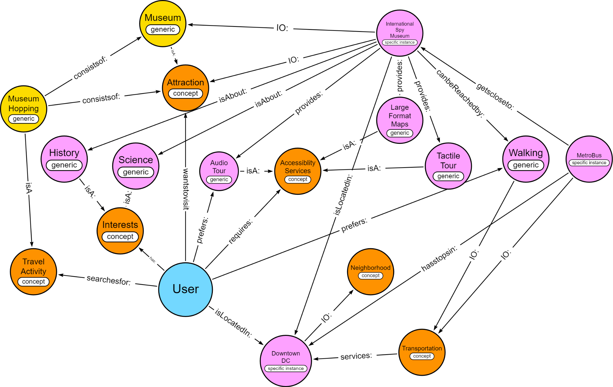
Knowledge Graph
Our user consults the guide to find somewhere to visit in the afternoon after her work meeting that is close to where she is located, suits her interests, and offers accessibility services that would enhance her visiting experience.
Notes:
Put our persona here

Slide 12


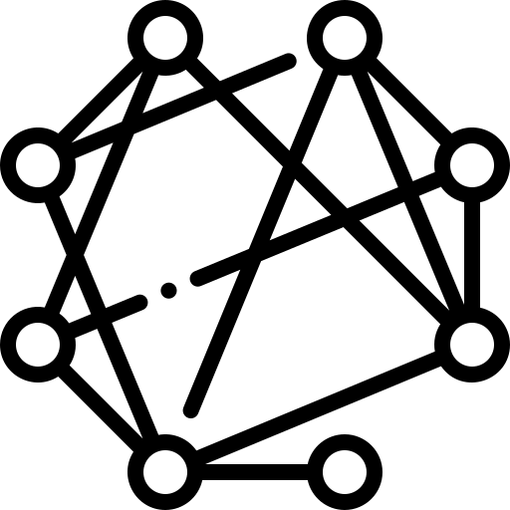

Knowledge Graph Uses for this Project
Build semantic relationships between terms
Help to understand user information seeking based on our persona
Aid in the creation of our ontology
Visualize relationships between terms
Notes:
Put our persona here

Slide 13
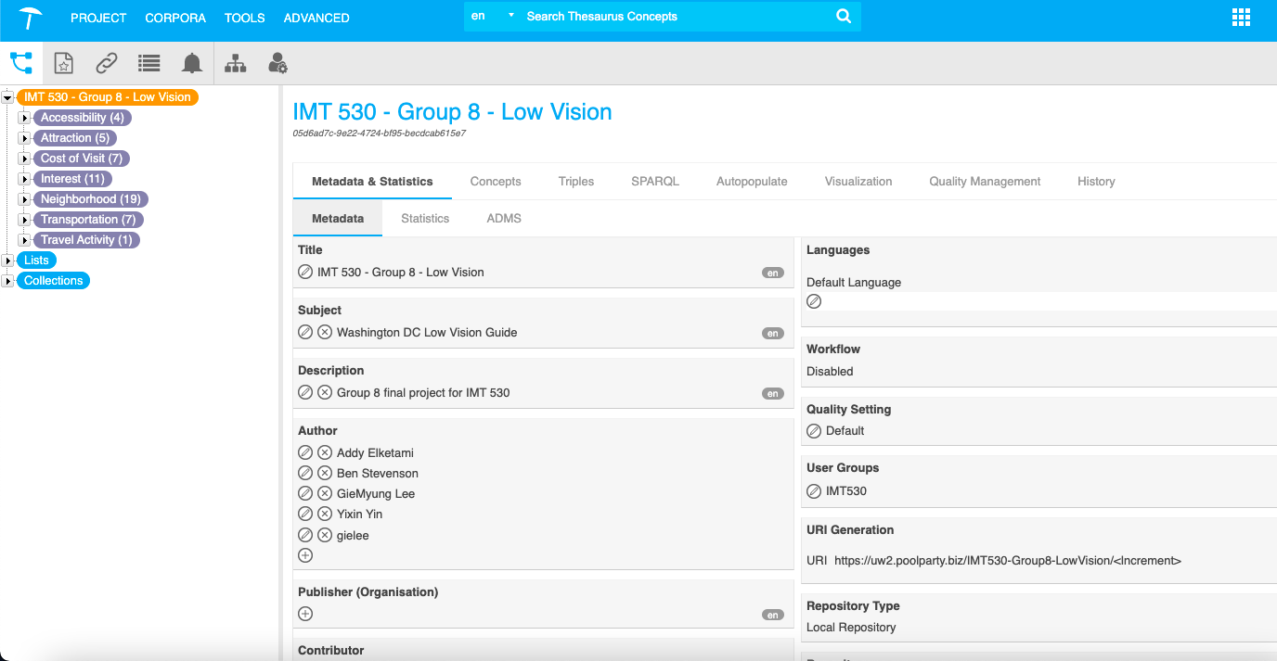
Taxonomy - First Level
Notes:
Put our persona here

Slide 14
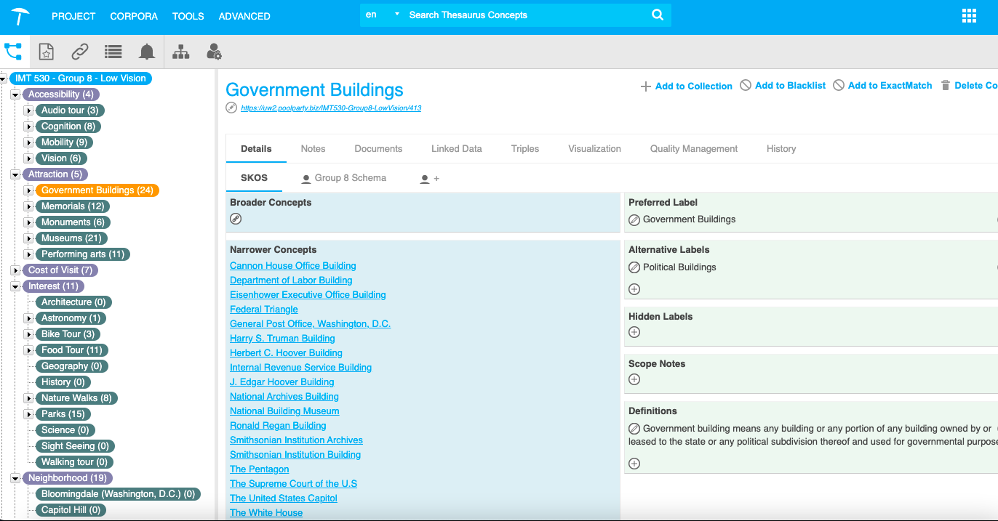
Taxonomy - Second Level
Notes:
Put our persona here

Slide 15
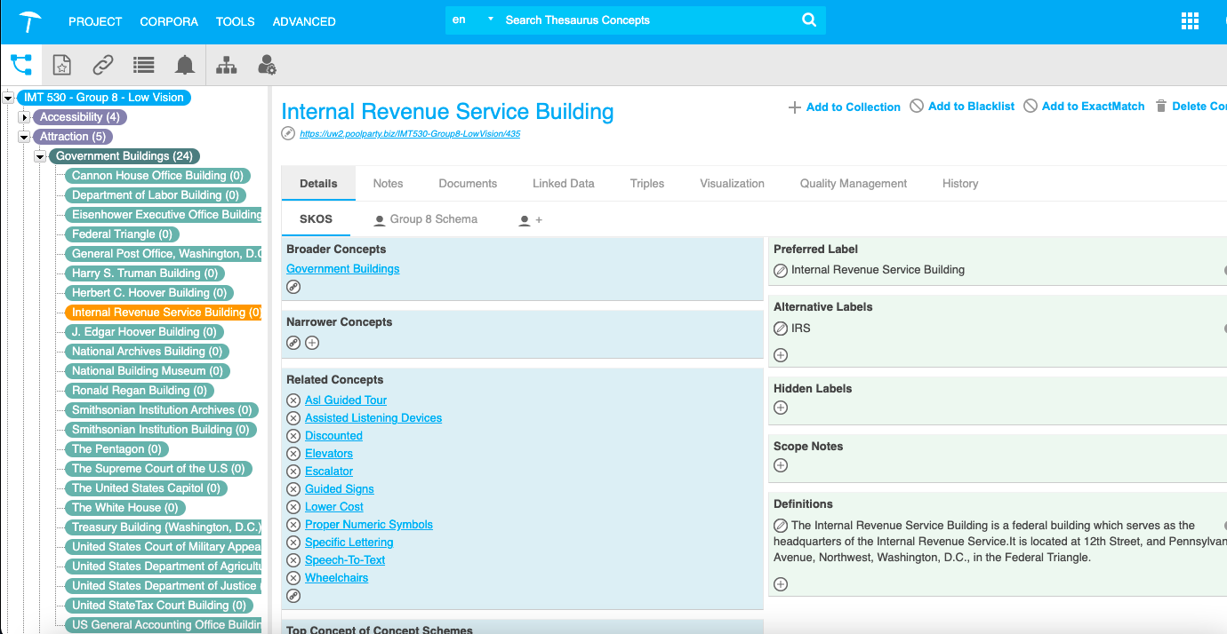
Taxonomy - Third Level
Notes:
Put our persona here

Slide 16
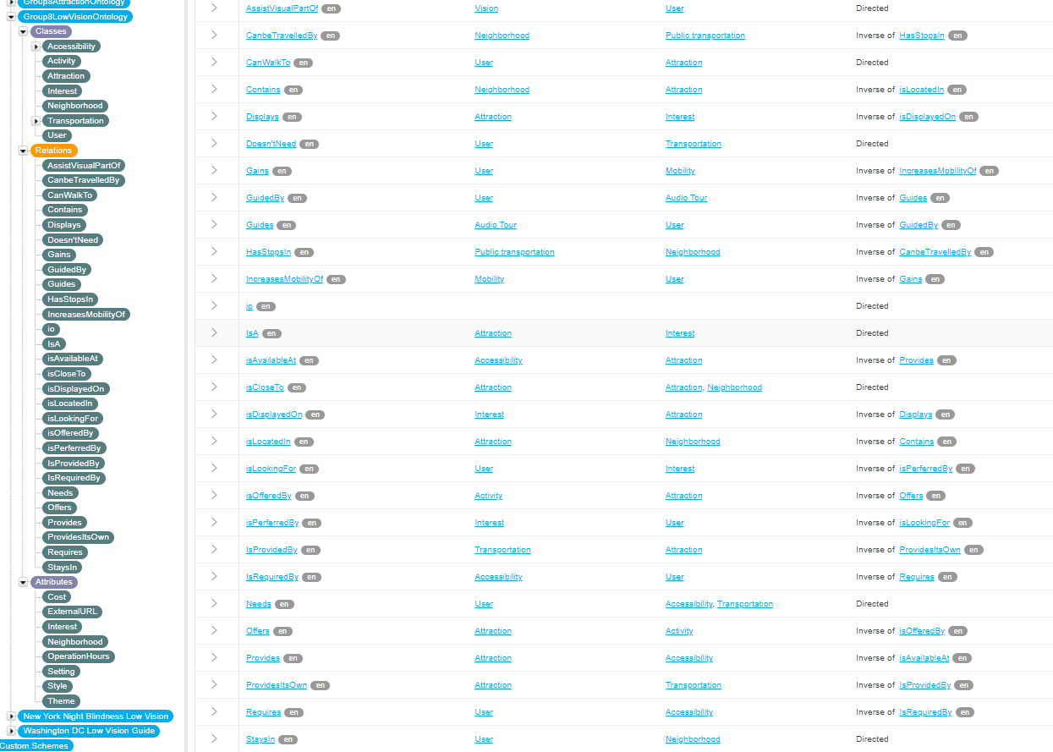
Ontology
Notes:
Put our persona here

Slide 17
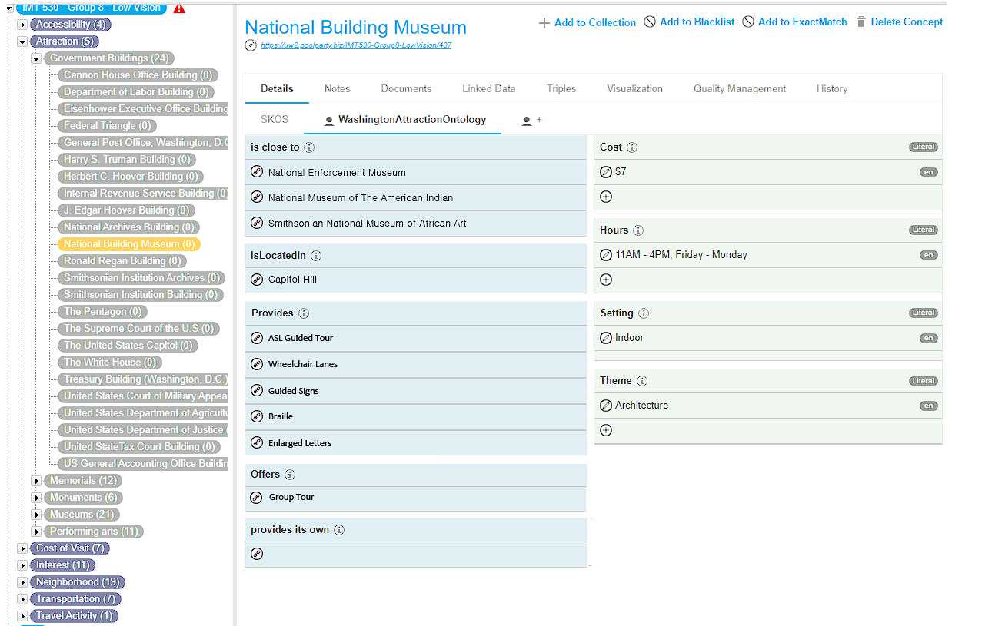
Ontology - Schema
Notes:
Put our persona here

Slide 18
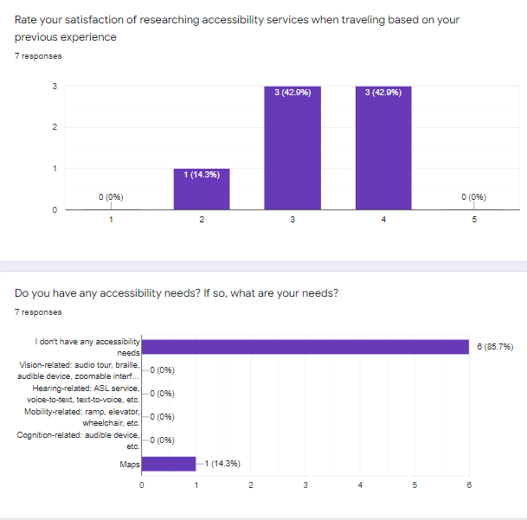
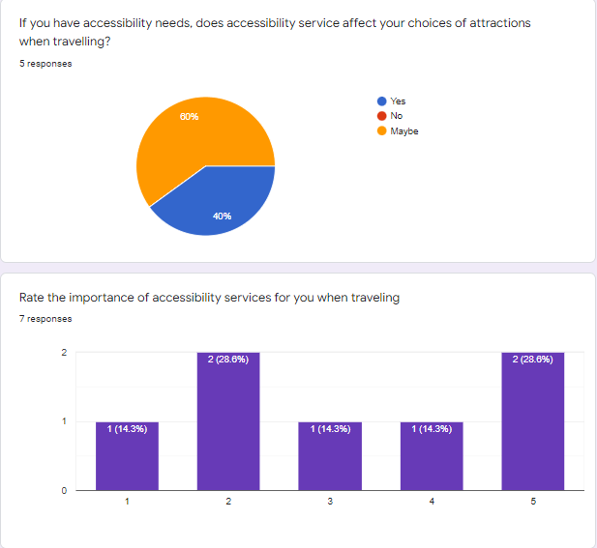
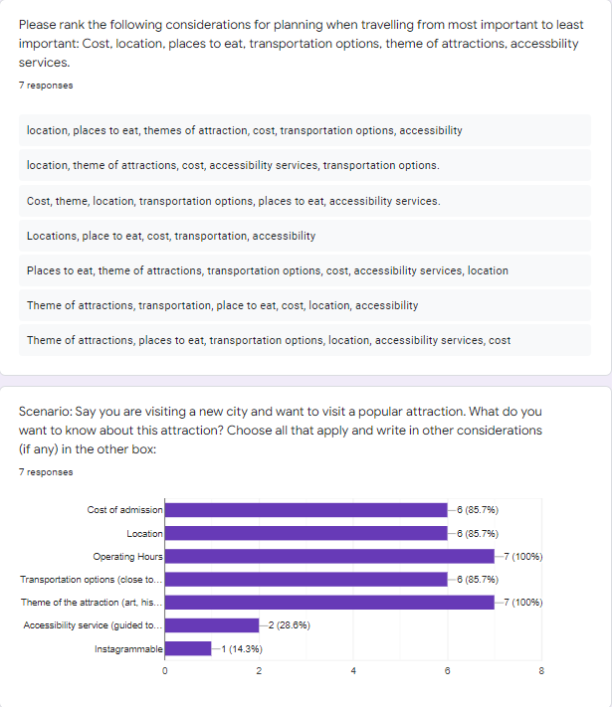
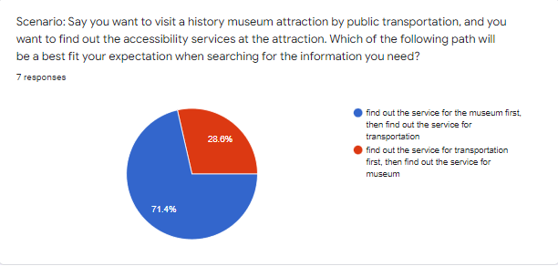
Survey

Slide 19
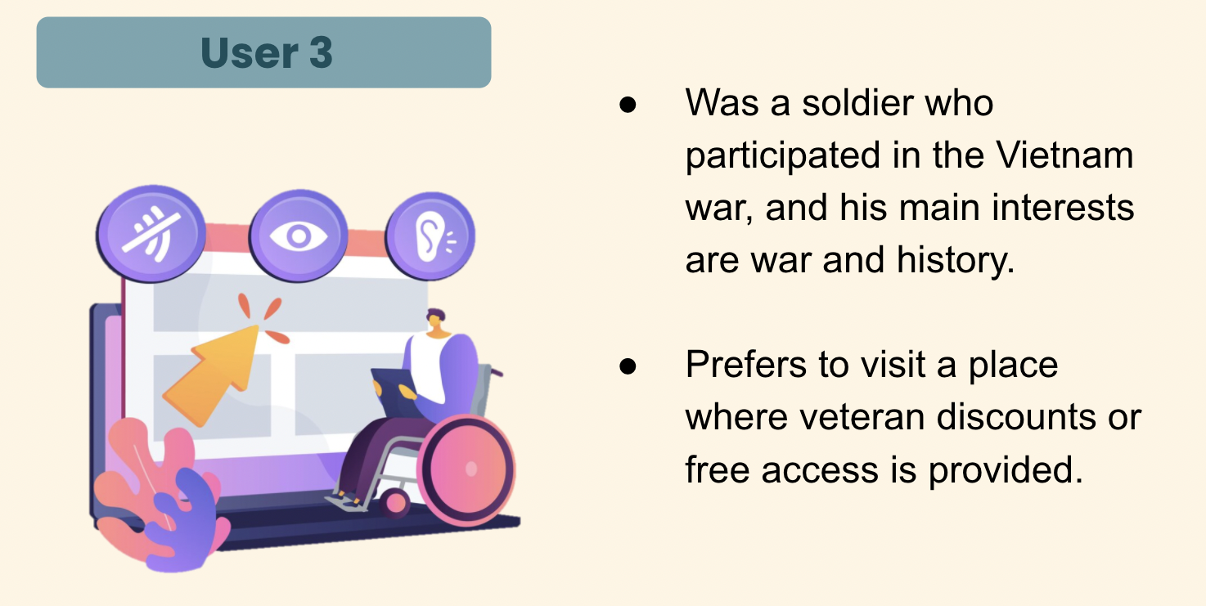
Challenges
Lack of access to feedback from low vision users.
Determining the scope of the taxonomy and ontology
Working with PoolParty!
Corpus Analysis
Limitations to collaborative working.
UI/UX Design
Notes:
The broadness of traveling and accessibility was a challenge. We did not have any feedback from low vision users which was also challenging and not ideal for our project. Feedback from real users would be absolutely necessary to realize this project.
PoolParty was challenging to work with because of it’s limitations for collaborative working.
We were also unable to link directly to another project at this stage because of the server splits.

Slide 20
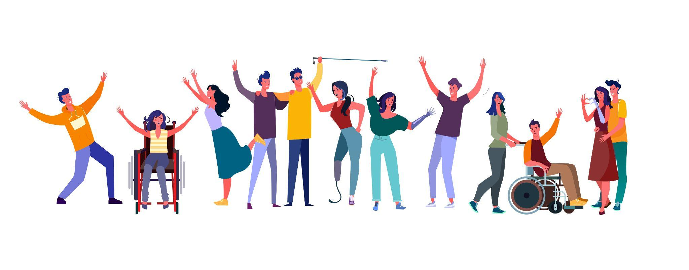
Conclusion
Travel Service Company
Customer Loyalty
Opening door for disability
Learning different perspectives
Notes:
The broadness of traveling and accessibility was a challenge. We did not have any feedback from low vision users which was also challenging and not ideal for our project. Feedback from real users would be absolutely necessary to realize this project.
PoolParty was challenging to work with because of it’s limitations for collaborative working.
We were also unable to link directly to another project at this stage because of the server splits.

Slide 21


